Slide 1



Perth Machine Learning Group
https://bit.ly/2H8F7j2
#PerthMLGroup

Slide 2


Perth Machine Learning Group
https://bit.ly/2H8F7j2
#PerthMLGroup

Slide 3

PMLG.org
www
Recommended Course:
www.fast.ai
forums.fast.ai

Slide 4
PMLG.org
www
GENERAL ADVICE WARNING
DISCLAIMER
All statements made by PMLG are made in good faith and we believe they are accurate and reliable. PMLG does not give any warranty as to the accuracy, reliability or completeness of information that is contained in its media, except in so far as any liability under statute cannot be excluded. PMLG, its directors, employees and their representatives do not accept any liability for any error or omission in any PMLG media, correspondence or events or for any resulting loss or damage suffered by the recipient or any other person. Unless otherwise specified, copyright of information provided on PMLG media are the property of PMLG.
The information provided on and through all PMLG media, correspondence and events is general in nature only and does not constitute personal advice. The information has been prepared without taking into account your personal objectives, situation or needs. Before acting on any information on this website you should consider the appropriateness of the information having regard to your objectives, situation and needs. Therefore, before you decide to act on any information, buy any product or keep or cancel a similar product that you already hold. Before making any decision, it is important for you to consider these matters and to seek appropriate technical, legal and other professional advice.

Slide 5





Thanks to our sponsors:

Slide 6
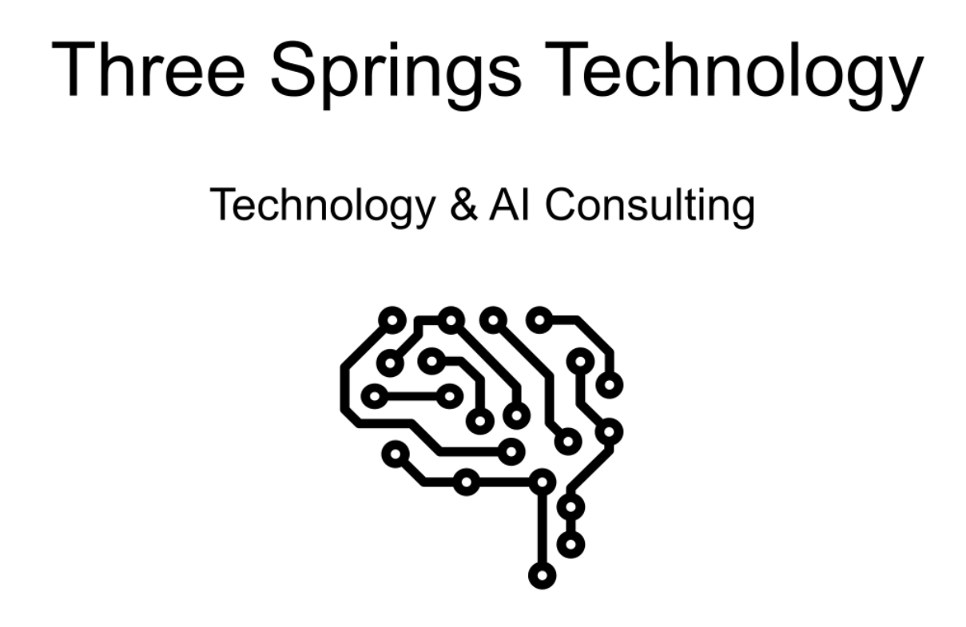

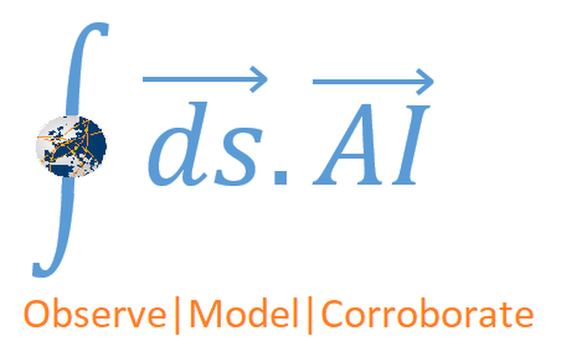


PMLG Expert Ecosystem:

Slide 7
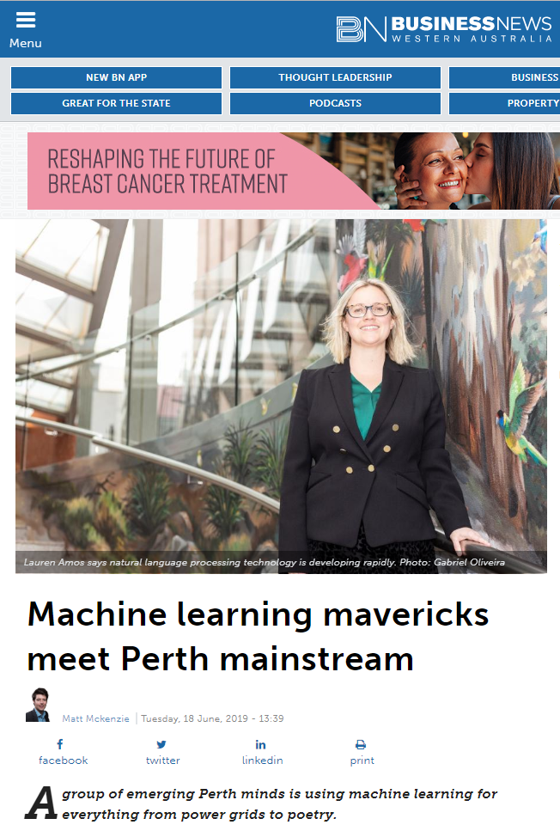
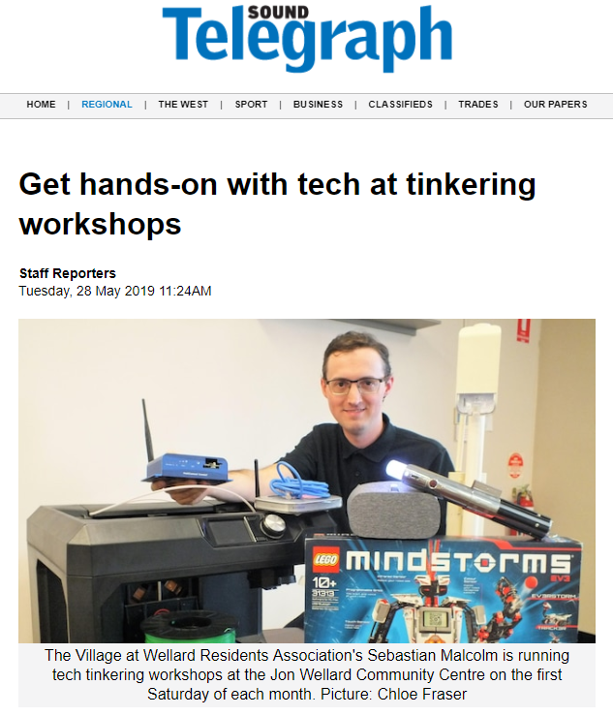
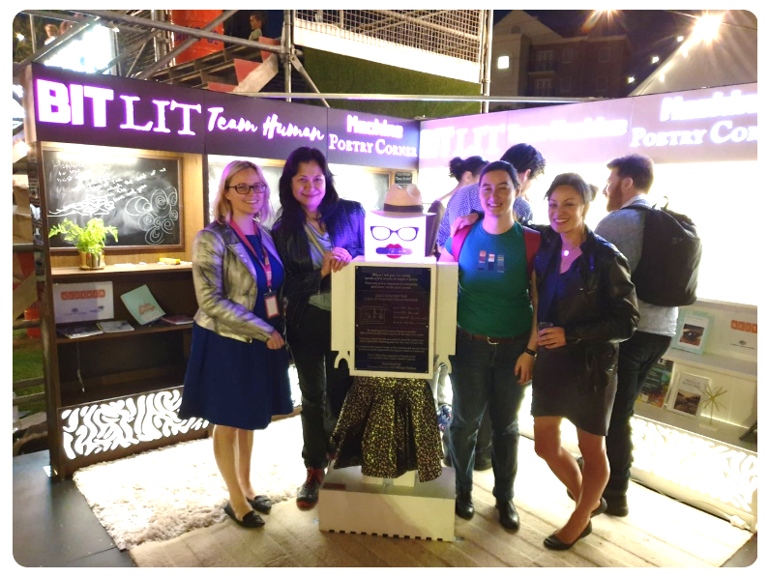
PMLG is more than a meetup
www
AI & Art exhibition in Fringe Festival

Slide 8
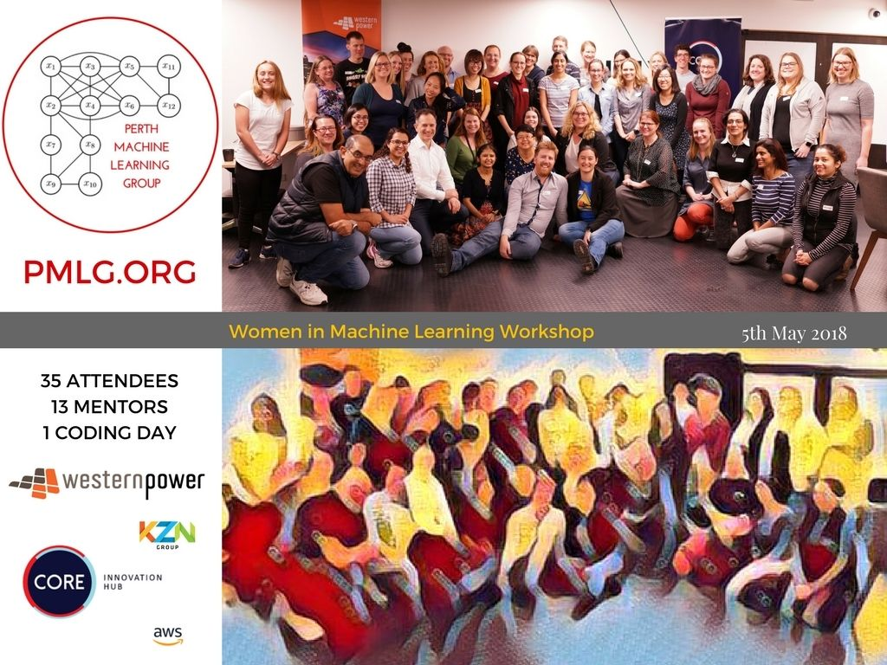
www

Slide 9
Run Down
www
Day 1
Data preparation, visualization and feature engineering for tabular data
<morning tea>
Machine Learning using Scikit-Learn models
Day 2
Intro to Deep Learning and its applications
Computer Vision for classification
<morning tea>
Image preparation for Computer Vision
Live demo for labelling tools
ML and beyond

